Slide 1
Digital I/O using the MSP430F5529
Lecture #6-7-8

Slide 2
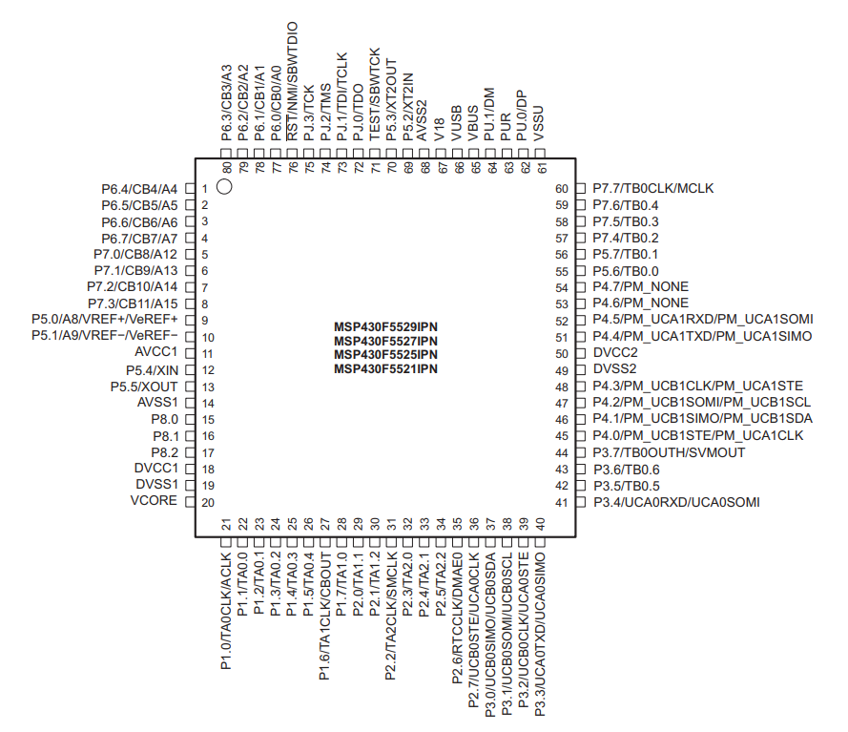
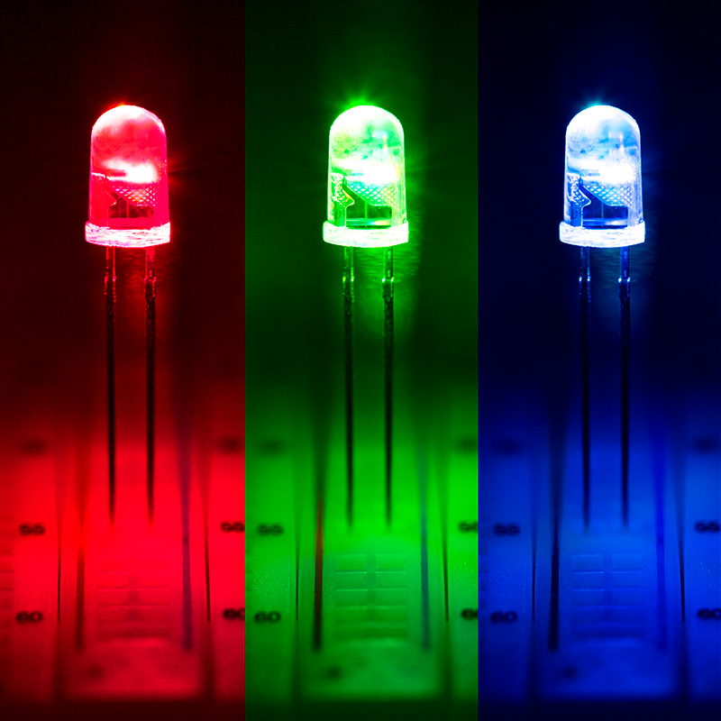
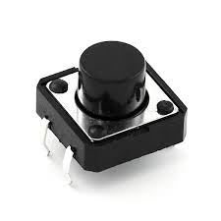
Digital I/O
Input (Read digital data, i.e. 3.3V-> 1)
Output (Write digital data, i.e. 0V -> 0)
Use the pins of the embedded system

Slide 3
MSP430F5529 Basic Digital I/O
>> Eight independent, individually configurable digital I/O ports
>> Ports 1-7 are each 8 bits wide, Port 8 is 3 bits wide
>> Each pin of each port can be configured individually as input or output
>> Each pin of each port can be individually read from or written to
>> Sequential ports can be logically combined to create 16 bit port
Port 1 & 2 together are Port A

Slide 4
MSP430F5529 Basic Digital I/O
>> Ports 1 and 2 can generate interrupts which are control signals that can be accepted or ignored by the '430
We'll be using interrupts later in term
>> Each port is controlled by six byte-addressable registers (i.e. 1 byte wide)
>> All the I/O port registers are memory mapped meaning each register associated with an IO port or other peripheral device has a unique address
and in CCS a predefined name (see msp430f5529.cmd and msp430f5529.h)

Slide 5
Digital I/O Registers
Function Select Registers
PxSEL bit is used to select the pin function – I/O port or peripheral module function
Bit = 0: I/O Function is selected for the pin
Bit = 1: Peripheral module function is selected for the pin
Ex: P3SEL = 0xF0;
Direction Registers
PxDIR register selects the direction of the corresponding I/O pin
Bit = 0: Port pin is switched to input direction
Bit = 1: Port pin is switched to output direction
Ex: P5DIR= 0x0F
Pins 7-4 = Inputs
Pins 3-0 = Outputs
I/O Port-x Pins
Px.7
Px.6
Px.5
Px.4
Px.3
Px.2
Px.1
Px.0
Bit7
Bit6
Bit5
Bit4
Bit3
Bit2
Bit1
Bit0

Slide 6
Digital I/O Registers
Input Registers
PxIN register reflects the value of the input signal at the corresponding I/O pin when the pin is configured as I/O function (read-only)
Bit = 0: Input is low
Bit = 1: Input is high
Ex: inValue = P2IN;
Output Registers
PxOUT register is the value to be output on the corresponding I/O pin when the pin is configured as I/O function
Bit = 0: Output is low
Bit = 1: Output is high
Ex: P4OUT = myOutByte;
Output Drive Strength Registers
PxDS register selects either full drive or reduced drive strength.
Bit = 0: Reduced drive strength
Bit = 1: Full drive strength

Slide 7
Digital I/O Registers
Pullup or Pulldown Resistor Enable Registers
PxREN register enables or disables the pullup/pulldown resistor of the corresponding I/O pin
The corresponding bit in the PxOUT register selects if the pin contains a pullup or pulldown
Bit = 0: Pullup/pulldown resistor disabled
Bit = 1: Pullup/pulldown resistor enabled
PxDIR | PxREN | PxOUT | I/O Configuration
0 | 0 | X | Input
0 | 1 | 0 | Input with pulldown resistor
0 | 1 | 1 | Input with pullup resistor
1 | X | X | Output

Slide 8
Digital I/O Registers
>> Using the digital I/O ports is conceptually simple...
Read or Write desired values from/to the register names associated with the port
(msp430f5529.cmd and msp430f5529.h)
>> Make extensive use of C's Bitwise operations → & | ~ (and &= |= ~=)
X | Y | Z=X & Y
0 | 0 | 0
0 | 1 | 0
1 | 0 | 0
1 | 1 | 1
X | Y | Z=X I Y
0 | 0 | 0
0 | 1 | 1
1 | 0 | 1
1 | 1 | 1
X | C=~X
0 | 1
1 | 0
X AND 0 = 0
X AND 1 = X
X OR 1 = 1
X OR 0 = X

Slide 9
Ex: Using CCS C configure Port 3 for digital I/O with Pins 1 and 0 as inputs and Pins 7 thru 4 and outputs
P3SEL = 0x0; // All pins selected for Dig I/O
P3DIR = 0xF0; //P3.7-4 are outputs P3.3-0 are inputs
Pin7
Pin0
. . . . . . . .
Port 3
Out
In

Slide 10
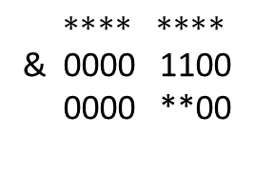
Is there a Better Way?
>> Pins might be used by other functions, so we should avoid overwriting them.
Preserve the settings of Pins 2 and 3.
>> This requires some bitwise operations
We will use AND and OR operations in combination to avoid overwriting certain bits
P3SEL:
Set necessary bits to 0
X X X X X X X X → 0 0 0 0 X X 0 0
$$∗∗∗∗ ∗∗∗∗$$
& 0000 1100
0000 **00
mask
0x0C

Slide 11
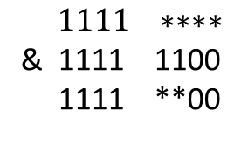
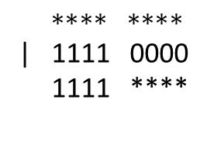
Is there a Better Way?
P3DIR:
Set necessary bits to 0 or 1
We can do it in 2 steps
X X X X X X X X → 1 1 1 1 X X 0 0
Step 1:
Step 2:
$$∗∗∗∗ ∗∗∗∗$$
| 1111 0000
1111 ****
mask
0xF0
$$1111 ∗∗∗∗$$
& 1111 1100
1111 **00
mask
0xFC

Slide 12
Is there a Better Way?
In C:
P3SEL = P3SEL & 0x0C;
P3DIR = P3DIR | 0xF0;
P3DIR = P3DIR & 0xFC;

Slide 13
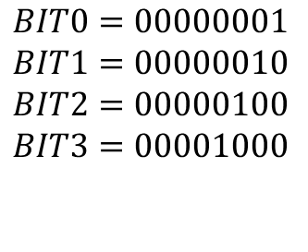
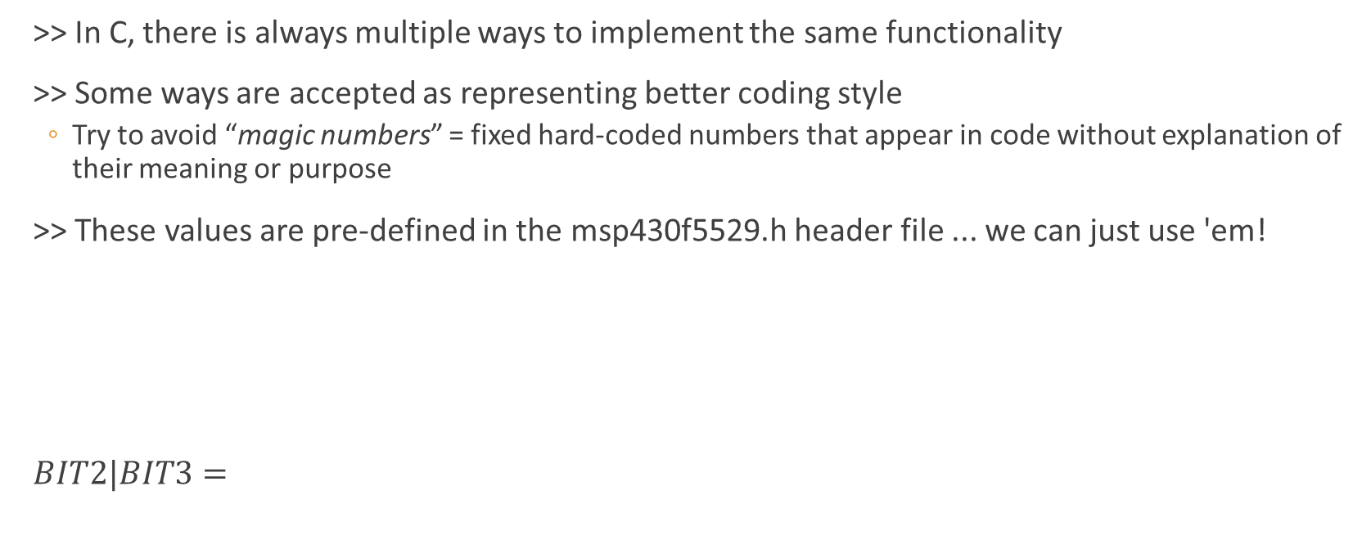
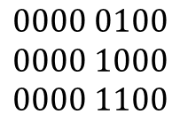
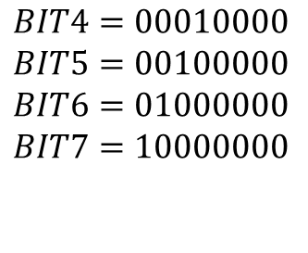
Avoiding “Magic Numbers”
>> In C, there is always multiple ways to implement the same functionality
>> Some ways are accepted as representing better coding style
Try to avoid “magic numbers” = fixed hard-coded numbers that appear in code without explanation of their meaning or purpose
>> These values are pre-defined in the msp430f5529.h header file ... we can just use 'em!
$BIT2|BIT3=$
$$BIT0=00000001$$
$$BIT1=00000010$$
$$BIT2=00000100$$
$$BIT3=00001000$$
$$BIT4=00010000$$
$$BIT5=00100000$$
$$BIT6=01000000$$
$$BIT7=10000000$$
$$0000 0100 \\ 0000 1000 \\ 0000 1100$$
$$\sim \left(BIT1 | BIT0\right)=NOT\left(00000010 OR 00000001\right)=1111 1100b$$

Slide 14
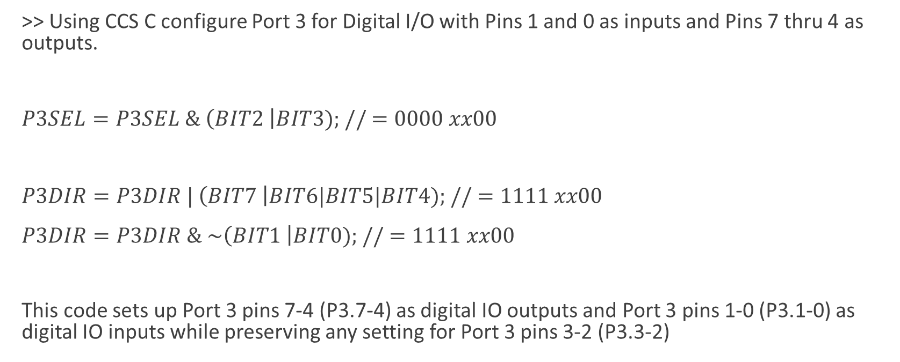
Previous Example
>> Using CCS C configure Port 3 for Digital I/O with Pins 1 and 0 as inputs and Pins 7 thru 4 as outputs.
$P3SEL=P3SEL \& \left(BIT2 \right|BIT3); // =0000 xx00$
$P3DIR=P3DIR | \left(BIT7 \right|BIT6|BIT5|BIT4); // =1111 xx00$
$P3DIR=P3DIR \& \sim \left(BIT1 \right|BIT0); // =1111 xx00$
This code sets up Port 3 pins 7-4 (P3.7-4) as digital IO outputs and Port 3 pins 1-0 (P3.1-0) as digital IO inputs while preserving any setting for Port 3 pins 3-2 (P3.3-2)

Slide 15
Example
>> Read in from properly configured Port 3 Pins 1-0 and place a 1 on the outputs. Pins 7-4 that correspond to the binary code 0-3 on Pins 1-0. Pin 4 should represent 0 and Pin 7 should be 3.
char inbits;
inbits = P3IN & (BIT0|BIT1); //This reads in from Port 3 keeping only bits 1 and 0. Rest are set to 0
P3OUT &= ~(BIT7|BIT6|BIT5|BIT4); //clear output bits
switch (inbits){
case 0:
P3OUT = P3OUT|BIT4;
break;
case 1:
P3OUT = P3OUT|BIT5;
break;
case 2:
P3OUT = P3OUT|BIT6;
break;
case 3:
P3OUT = P3OUT|BIT7;
break;
}

Slide 16
Another Example
>> Write a function that reads the low nibble from P6 into a byte (use internal pull-up resistors), and another functions that outputs the complement of the low nibble of its input argument on P47-4.
void portConfig()
{
/* Setup P6.3 0 as digital IO inputs with pull up resistors */
P6SEL = P6SEL & ~(BIT3|BIT2|BIT1|BIT0);
P6DIR = P6DIR & ~(BIT3|BIT2|BIT1|BIT0);
P6REN = P6REN | (BIT3|BIT2|BIT1|BIT0);
P6OUT = P6OUT | (BIT3|BIT2|BIT1|BIT0);
/* Setup P4.7 4 as digital IO outputs */
P4SEL &= ~(BIT7|BIT6|BIT5|BIT4);
P4DIR &= (BIT7|BIT6|BIT5|BIT4);
}

Slide 17
Another Example
char in_P6(){
// Read in from port 6. Save only the low
char inbits; // local variable
inbits = P6IN & 0x0F;
return(inbits); // return the value inbits
}
void out_comp_P4(char inByte){
char outbits;
// Complement input value, inByte
outbits = ~inByte;
// Shift low nibble left to bits 7 4
outbits = outbits << 4;
//output on P4.7 4
P4OUT = (outbits & 0xF0) | (P4OUT & 0x0F);
}

Slide 18
Another Example
>> An example of calling these functions inside a main() …
int main(){
...
portConfig();
inData = in_P6(); // inData is locally defined char
out_comp_P4(inData);
... }

Slide 19
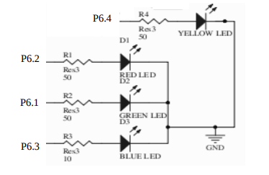
Input or Output?
>> Let's take a closer look at the digital IO devices on our lab board starting with the 4 multi-colored LED's ....
On what port and pins are these LEDs connected? (are they an input or output device?)
--> Check board Schematics posted and/or look thru demo project

Slide 20
How do the LED functions work?
>> Consider Blue Led…
Logic 0 = 0V = GND
Logic 1 = 3V = VCC
If P6.3 = 0V then there is no voltage drop across LED.
Led cannot turn on
If P6.3 = 3.3V = 1 then there is a voltage drop across LED
P6.3

Slide 21
Led Init in MSP430 board
void initLeds(void){
// Configure LEDs as outputs, initialize to logic low (off)
// Note the assigned port pins are out of order test board
// Red P6.2
// Green P6.1
// Blue P6.3
// Yellow P6.4
// smj -- 27 Dec 2016
P6SEL &= ~(BIT4|BIT3|BIT2|BIT1);
P6DIR |= (BIT4|BIT3|BIT2|BIT1);
P6OUT &= ~(BIT4|BIT3|BIT2|BIT1);
}

Slide 22
>> In an application program like the demo project the digital I/O ports are used repeatedly. The application programmer wraps the specific port functionalities by placing the assignments to the port specific registers into useful C functions.
void setLeds(unsigned char state){
// Turn on 4 colored LEDs on P6.1-6.4 to match the hex value
// passed in on low nibble state. Unfortunately the LEDs are
// out of order with 6.2 is the left most (i.e. what we think
// of as MSB), then 6.1 followed by 6.3 and finally 6.4 is
// the right most (i.e. what we think of as LSB) so we have
// to be a bit clever in implementing our LEDs
//
// Input: state = hex values to display (in low nibble)
// Output: none
//
// smj, ECE2049, 27 Dec 2015
unsigned char mask = 0;
// Turn all LEDs off to start
P6OUT &= ~(BIT4|BIT3|BIT2|BIT1);
if (state & BIT0)
mask |= BIT4; // Right most LED P6.4
if (state & BIT1)
mask |= BIT3; // next most right LED P.3
if (state & BIT2)
mask |= BIT1; // third most left LED P6.1
if (state & BIT3)
mask |= BIT2; // Left most LED on P6.2
P6OUT |= mask;
}

Slide 23
>> These functions are easy to manipulate and can be re-sued in other applications with same hardware
>> main() is then a series of calls to functions whose names convey their purpose …
Initialize once and reuse many times
void main(void){
...
// Stop WDT
WDTCTL = WDTPW | WDTHOLD; // Stop watchdog timer
initButtons();
initLeds();
configDisplay();
configKeypad();
...
while (1) {
...
setLeds(some_val);
...
}
}

Slide 24
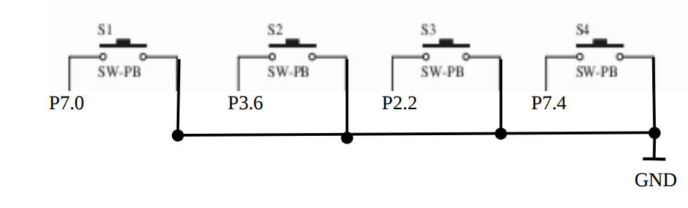
What about buttons?
>> There are 2 on Launchpad and 4 on the board. These are the lab board buttons.
>> Notice no external pull resistors used.
Need to configure internal pull resistors on these pins (PxREN)
--> Do they need to be Pull-UP or Pull-DOWN?

Slide 25
Pull-Up/Pull-Down
MSP430
>> Need pull-resistor to “assign” default Logic State of P7.0 input
Otherwise P7.0 would be floating in some unknown state!
>> Only needed for Inputs!
>> Outputs will not need internal pull resistors. Outputs will take on whatever voltage (0v or 3.3V) is assigned to that bit.
>> When Button Not Pressed (switch open)
P7.0 is at Logic 1
>> When Button Pressed (switched closed)
P7.0 is at Logic 0
Vcc
P7.0
Pull-up
MSP430
Vcc
Pull-down

Slide 26
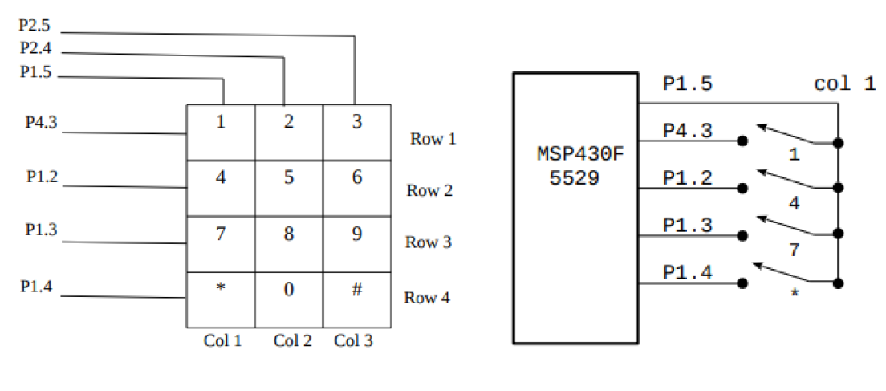
What about keypad?
void configKeypad(void) {
// Configure digital IO for keypad
// smj -- 27 Dec 2015
// Col1 = P1.5 =
// Col2 = P2.4 =
// Col3 = P2.5 =
// Row1 = P4.3 =
// Row2 = P1.2 =
// Row3 = P1.3 =
// Row4 = P1.4 =
// Select pins for digital IO
P1SEL &= ~(BIT5|BIT4|BIT3|BIT2);
P2SEL &= ~(BIT5|BIT4);
P4SEL &= ~(BIT3);
// Columns are ?
P2DIR |= (BIT5|BIT4);
P1DIR |= BIT5;
P2OUT |= (BIT5|BIT4); //
P1OUT |= BIT5; //
// Rows are ?
P1DIR &= ~(BIT2|BIT3|BIT4);
P4DIR &= ~(BIT3);
P4REN |= (BIT3); //
P1REN |= (BIT2|BIT3|BIT4);
P4OUT |= (BIT3); //
P1OUT |= (BIT2|BIT3|BIT4);
}

Slide 27
Pooling
>> How do you now monitor and use your properly configured digital I/O ports?
---> By repeatedly checking if button status has changed!
--> Without the swDelay main loop executes << 1 ms
Code will Poll the buttons ~10,000 to 100,000 times per second!
--> First thing that happens in each loop is to check the button!
Inside demo project main.c
while (1) // Forever loop{
ret_val = readButtons();
setLeds(~ret_val);
...
}

